Slide 1
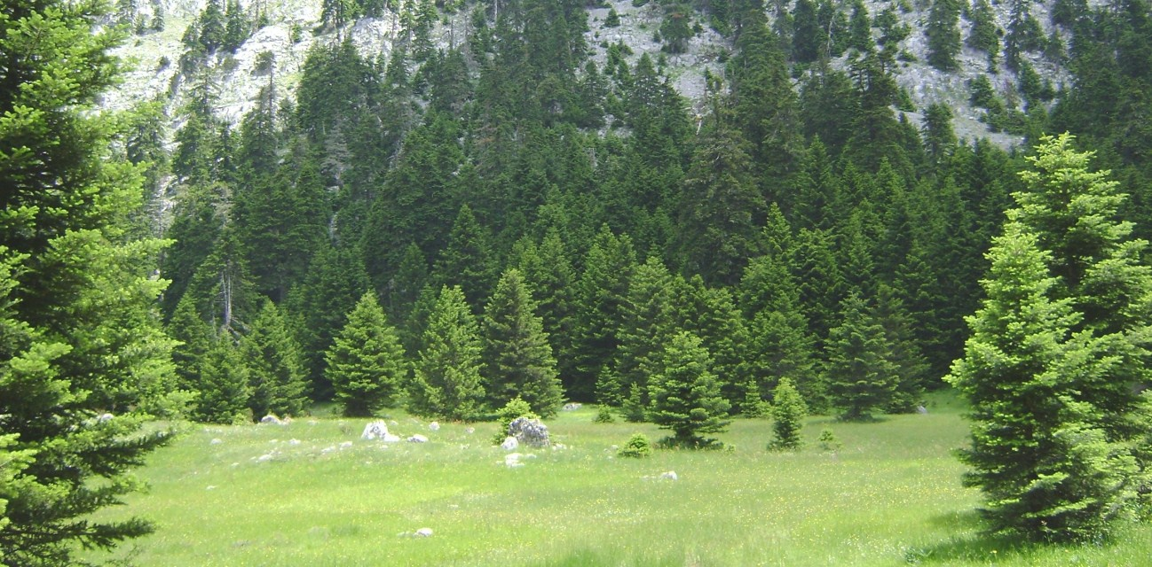
Summer School on Education Sustainable Development
in biosphere reserves and other designated areas
Prepared by:
Maria Dimopoulou
Galatia Politopoulou
Gizem Şahin
Petra Krmac
Vinciane Auguste
Topic: The fire risks in the area of Parnassos National Park.
Review of existing fire risk measures and campaigns and interventions to reduce fire risk in the protected area and proposal for their further development in the National Park and the surrounding region.
Amfissa, Greece, 17th July 2014

Slide 2
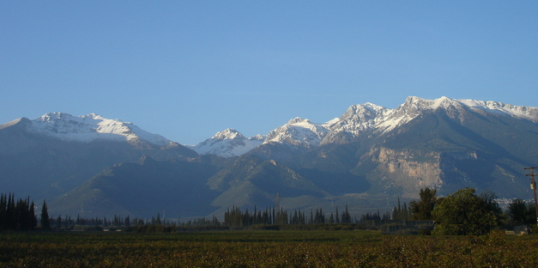
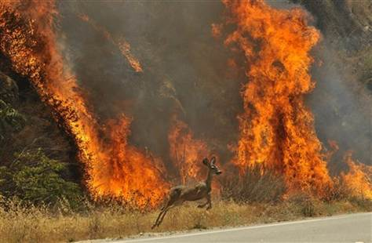
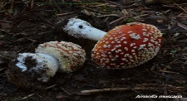
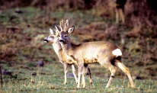
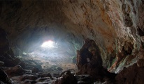
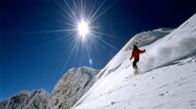
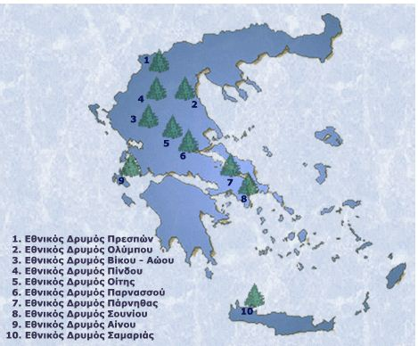
Fire risk at Parnassos National Park (PNP) and its management
Definition of fire risk:
something which is likely to cause a fire or make a fire worse
Sources of fire risk:
90% man-made
10% natural causes
Who is at risk?
People (inhabitants & visitors)
animals, forest

Slide 3
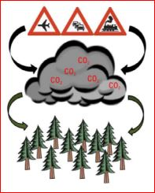
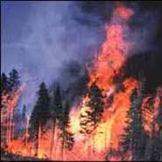
Aim & Methodology
Why this topic?
Aim
Work process
Review fire risk management on PNP
Propose improvement of fire risk management for PNP
Propose ESD related to fire risk in PNP
Research
Interviews
Observation &
writing
Brainstorming
Fire is part of forest ecology
Fire was novel topic for us
Good topic for educational intervention
On personal responsibility

Slide 4
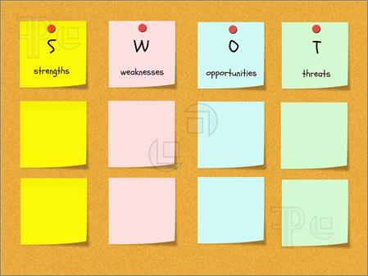
Results : SWOT analysis for fire risk
Patrolling
Fire corridors
Water tanks
Only 5 (to 9)
on patrol for 3,513 hectares
Rubbish in PNP
Water tanks plastic
Inhabitants&
Visitors to PNP
Inhabitants&
Visitors to PNP
Fire risk ESD & for best practice in PNP
Target visitors&children
Public information
Sessions
Educational
activities
like
tree-planting
Natural causes
Man made causes
e.g. waste,
arson
Fragmented fire
services
Few fire sings
Poor boundaries
Lack of fire risk
specific educational
activities

Slide 5
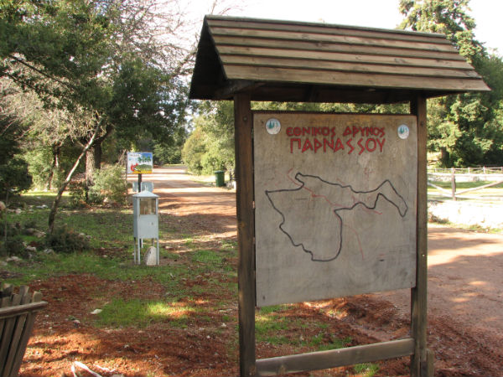
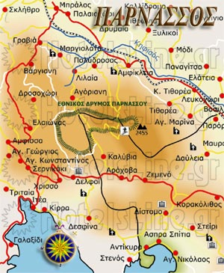
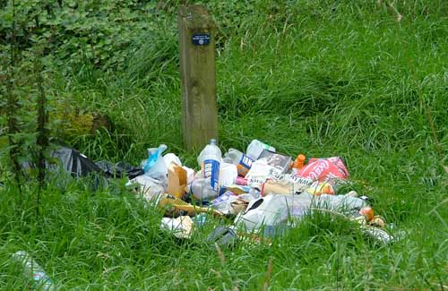
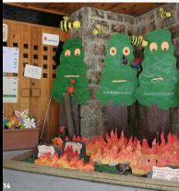
ESD for fire risk management
Build a fun program
of fire risk education
Visitors
Children
Information
Maps
(and map based games)
Rubbish collection
Biomass clearance
People have to be convinced that forest protection from fire is essential
and informed on how to participate in fire protection,
for any fire management plan to be effective. FAO Handbook for fire protection

Slide 6
Thank you for your attention
Ευχαριστούμε για την προσοχή !

